Slide 1
Vending
Machine
Using python

Slide 2


What Special
Calculative Automatically stops when remaining amount is 0
Operative Can ShutDown and Reset Machine
Simple Operate Machine 1-5 numbers
Keep Updated Shows Amount Remaining

Slide 3

How it works ?
This Vending machine takes the 1$ and 5$ .
This Machine shows products available and flavours. Customer can select options using 1,2,3,4 buttons. Machine dispenses product and change if any there. Machine shows the bill that we made purchase including the product name and Quantity of them.
Machine always shows how much money left more to buy and stops purchase ,when remaining amount is 0

Slide 4
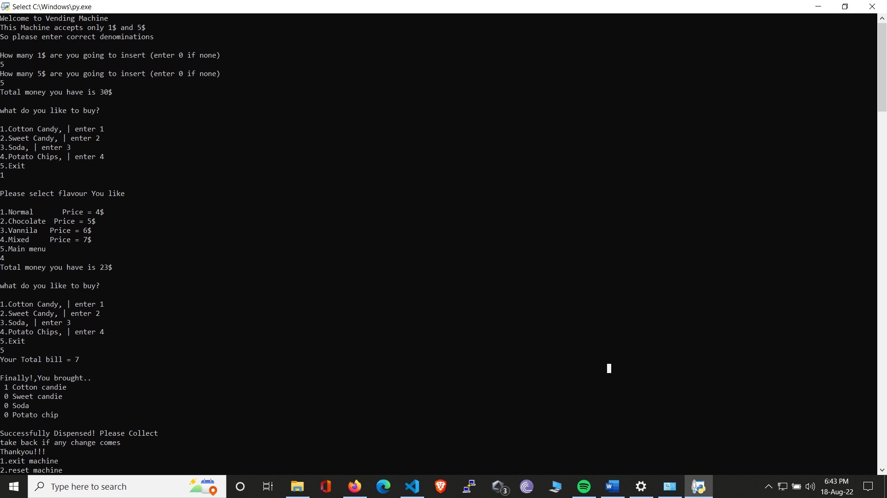
Look Here
This takes 1$ and 5$ separate
Automatically calculate total money you have
Operable using 1-5 numbers

Slide 5
Have a look
Shows Remaining Money after Purchase
Shows Total bill
Machine can be controlled

Slide 6
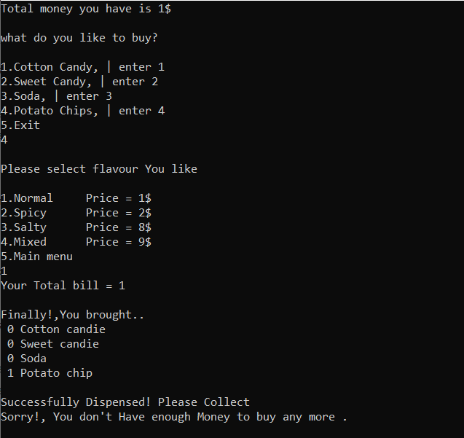
Have a look
Automatically stops when total remaining is 0
Shows , sorry message

Slide 7
What if we try to buy
Costlier product than money we have ?

Slide 8
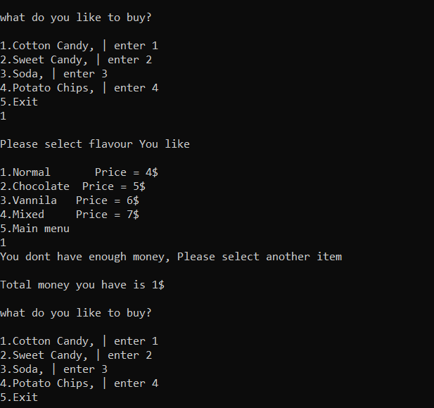
Have a look
Shows , Your money isn’t enough and ask you to buy another

Slide 9
Have you noticed exit and main menu ?

Slide 10
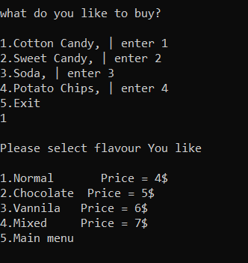
Have a look
Button 5 is specially for main menu and exit

Slide 11
Any Doubts?

Slide 12

ThankYou

